Slide 1
CHAPTER 13
Bioenergetics and Metabolism
Xiao-Wei Chen, Ph.D.
xiaowei_chen@pku.edu.cn

Slide 2
Reference letter
~10, <15 schools
Lab research
lipid/glucose metabolism
cell biology
>85 = coffee/drink
(before graduation)

Slide 3
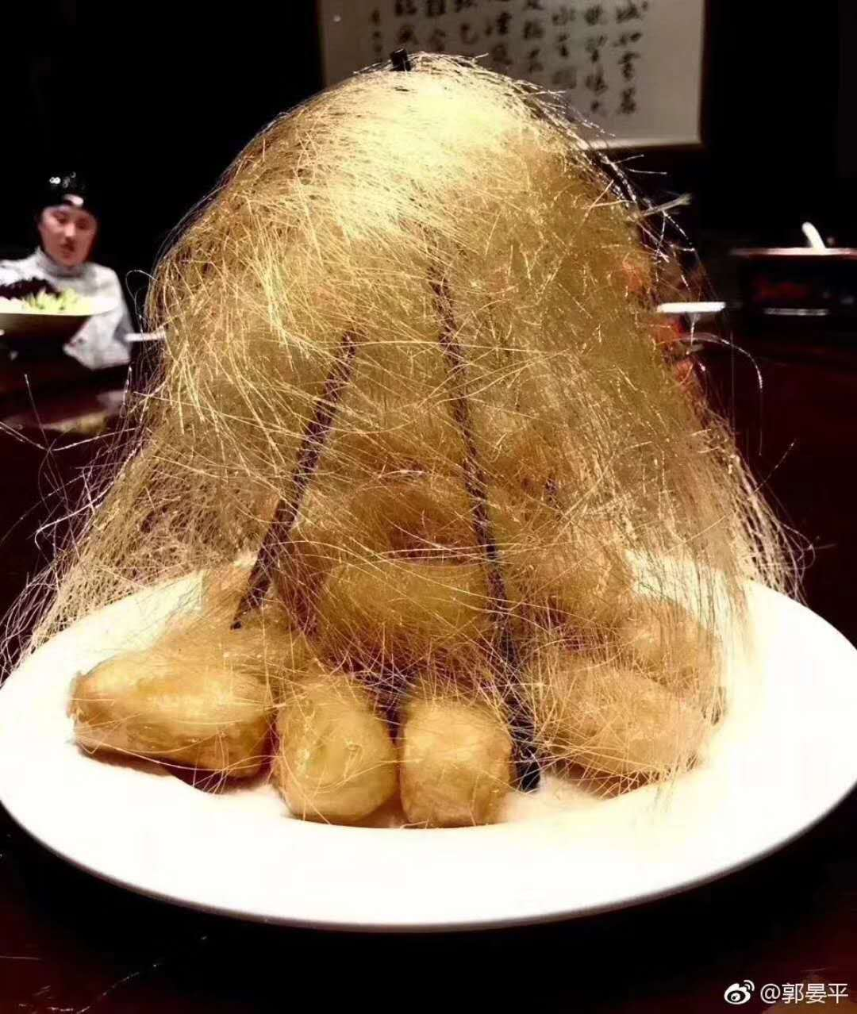

拔丝特朗普
Bust Trump

Slide 4
Outline of the lecture
Overview of metabolism
Bioenergetics
Summary of five types of biological reactions
ATP as the universal currency of biological energy
Reduction-oxidation reaction

Slide 5
Metabolism ( Greek metabolē, “Change”)
Metabolism is a term that is used to describe all chemical reactions involved in maintaining the living state of the cells and the organism.
The entire highly integrated and regulated network of consecutive enzyme-catalyzed chemical transformations (pathways) taking place in a living organism, through which cells in the organism grow and reproduce, maintain their structures, and respond to their environment.
Ways of dealing with energy

Slide 6
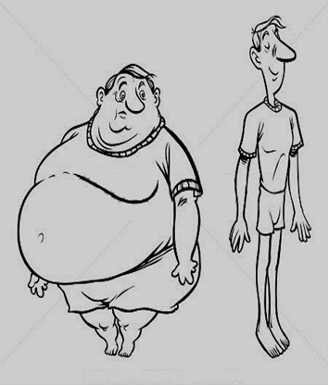

Slide 7
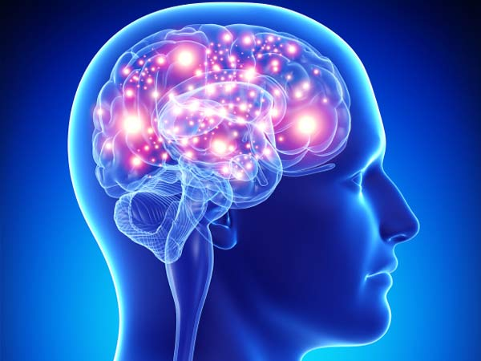
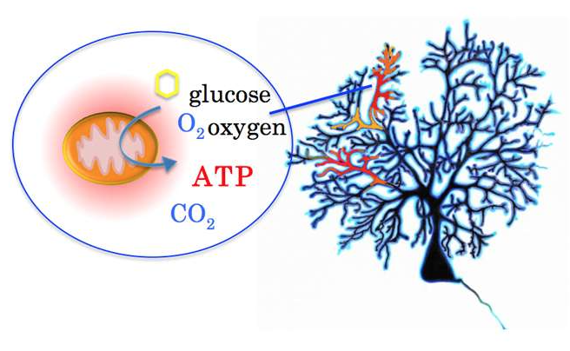
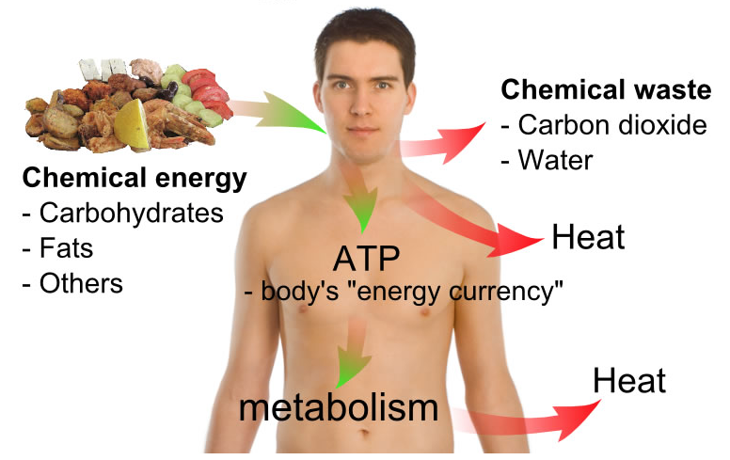

Slide 8
Autotrophs and Heterotrophs
Autotrophs (“self-feeding”)— Using CO₂ as sole carbon source to produce complex organic compounds and thus have to derive energy from sunlight or inorganic substances, Including green plants, algae, and certain bacteria. Being the “producers” in the food chain.
Heterotrophs (“feeding on others”)— Derive energy and carbon from oxidation of organic compounds (made by autotrophs); Including all animals and most bacteria and fungi. Being the “consumers” in the food chain.
Interconnected and interdependent

Slide 9
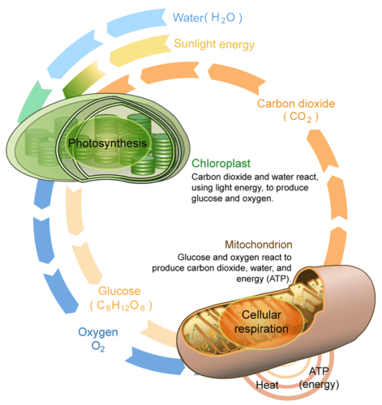
Photosynthesis and cell respiration
6 CO₂ + 6 H₂O
Light
Energy
C₆H₁₂O₆ + 6O₂

Slide 10
Anabolism and catabolism
Reductive
Oxidative

Slide 11
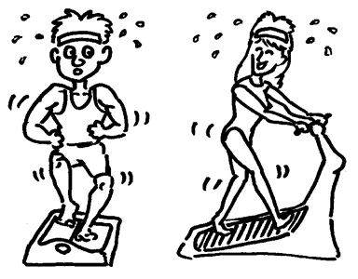
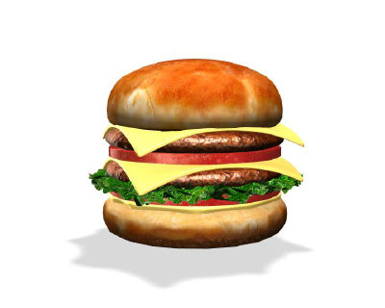
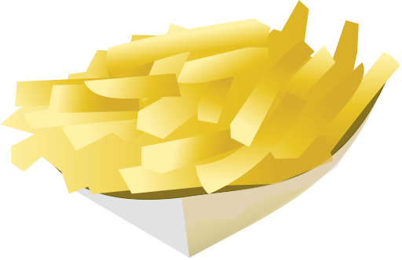
Unbalanced metabolism causes
The worldwide epidemic of obesity
Catabolism
Anabolism
Energy Intake
Energy Expenditure
Energy Balance

Slide 12
Anabolism and catabolism
From many to one
From one to many

Slide 13
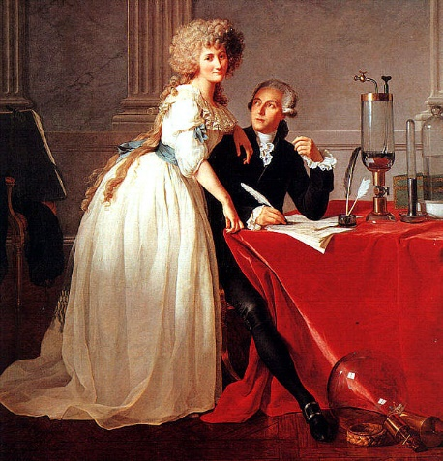
Bioenergetics
Lavoisier estimated heat produced (estimated from amount of ice melted) by animal’s metabolism: Animal respiration is nothing but slow combustion of carbon and hydrogen, like that of a candle burning (1789).
“The torch of life lights itself at the moment the infant breathes for the first time, and it does not extinguish itself except at death.” –Antonine Lavoisier
Issues concerned: Where is O₂ converted to CO₂ and H₂O? What contributes the carbon and hydrogen to form CO₂ and H₂O?
Antoine and Marie-Ann Lavoisier
Dismantle the Phlogiston theory
(燃素学说)

Slide 14
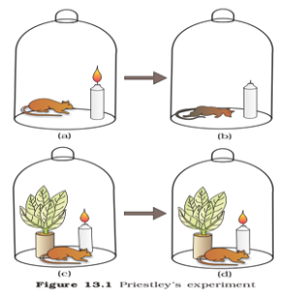
the mouse dies exactly at the time where the flame of the candle goes out
having a plant in the jar makes the flame to burn longer and the mouse to live longer
Conclusion
The flame and the mouse both consume a gas from the air
This gas is produced by the plant and is released into the environment
The respiration process equals a combustion reaction
‘La respiration et donc une combustion’

Slide 15
The second law of thermodynamics
In all natural process, the entropy of the universe increases
G, Gibbs free energy, expresses the amount of an energy capable of doing work, at constant temperature and pressure.
H, Enthalpy, is the heat content of the reacting system
Loss of heat, ΔH is negative.
S, Entropy, is a quantitative measure of the randomness in a system.
Increase of randomness, ΔS is positive.

Slide 16
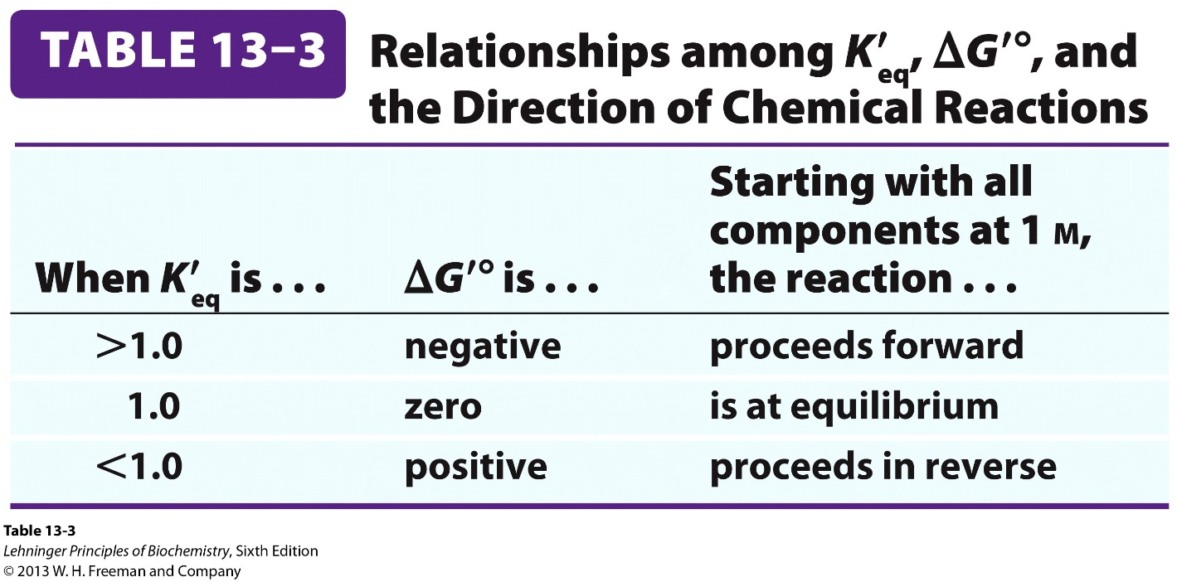
ΔG'º is linked to K'_{eq} (equilibrium constant)
Gibbs developed the chemical thermodynamics: relating free-energy change with equilibrium constant.
The standard free-energy change (ΔG'º): a physical constant measured under a standard set of conditions (all reactants and products start at 1 M or 1 atm, 25ºC and at pH 7).
ΔG' º = -RT ln K'_{eq} (K'_{eq}: equilibrium constant)
Exergonic
Endergonic

Slide 17

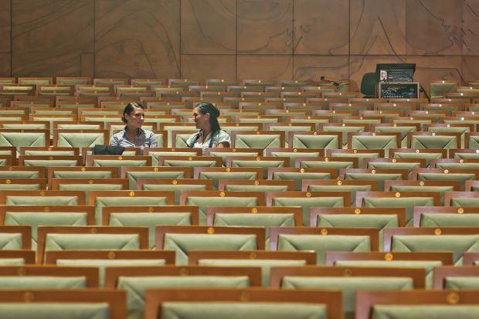
Coming to biochemistry class
Against the second law of thermodynamics
So it requires some work/energy

Slide 18
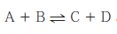
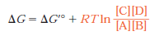
The actual free-energy change and spontaneity/directionality
All these parameters (indicated by a prime) are used in their “transformed” form in biochemistry (different from those of chemistry and physics).
The actual free-energy change (ΔG ): A variable indicating the magnitude of force driving a reaction towards equilibrium.
ΔG = ΔG'º + RT ln Q (Q = [products]/[reactants], mass-action ratio)
ΔG for a reaction can be larger, smaller, or the same as ΔG'º, depending on the concentrations of the reactants and products (Q: mass action ratio).

Slide 19
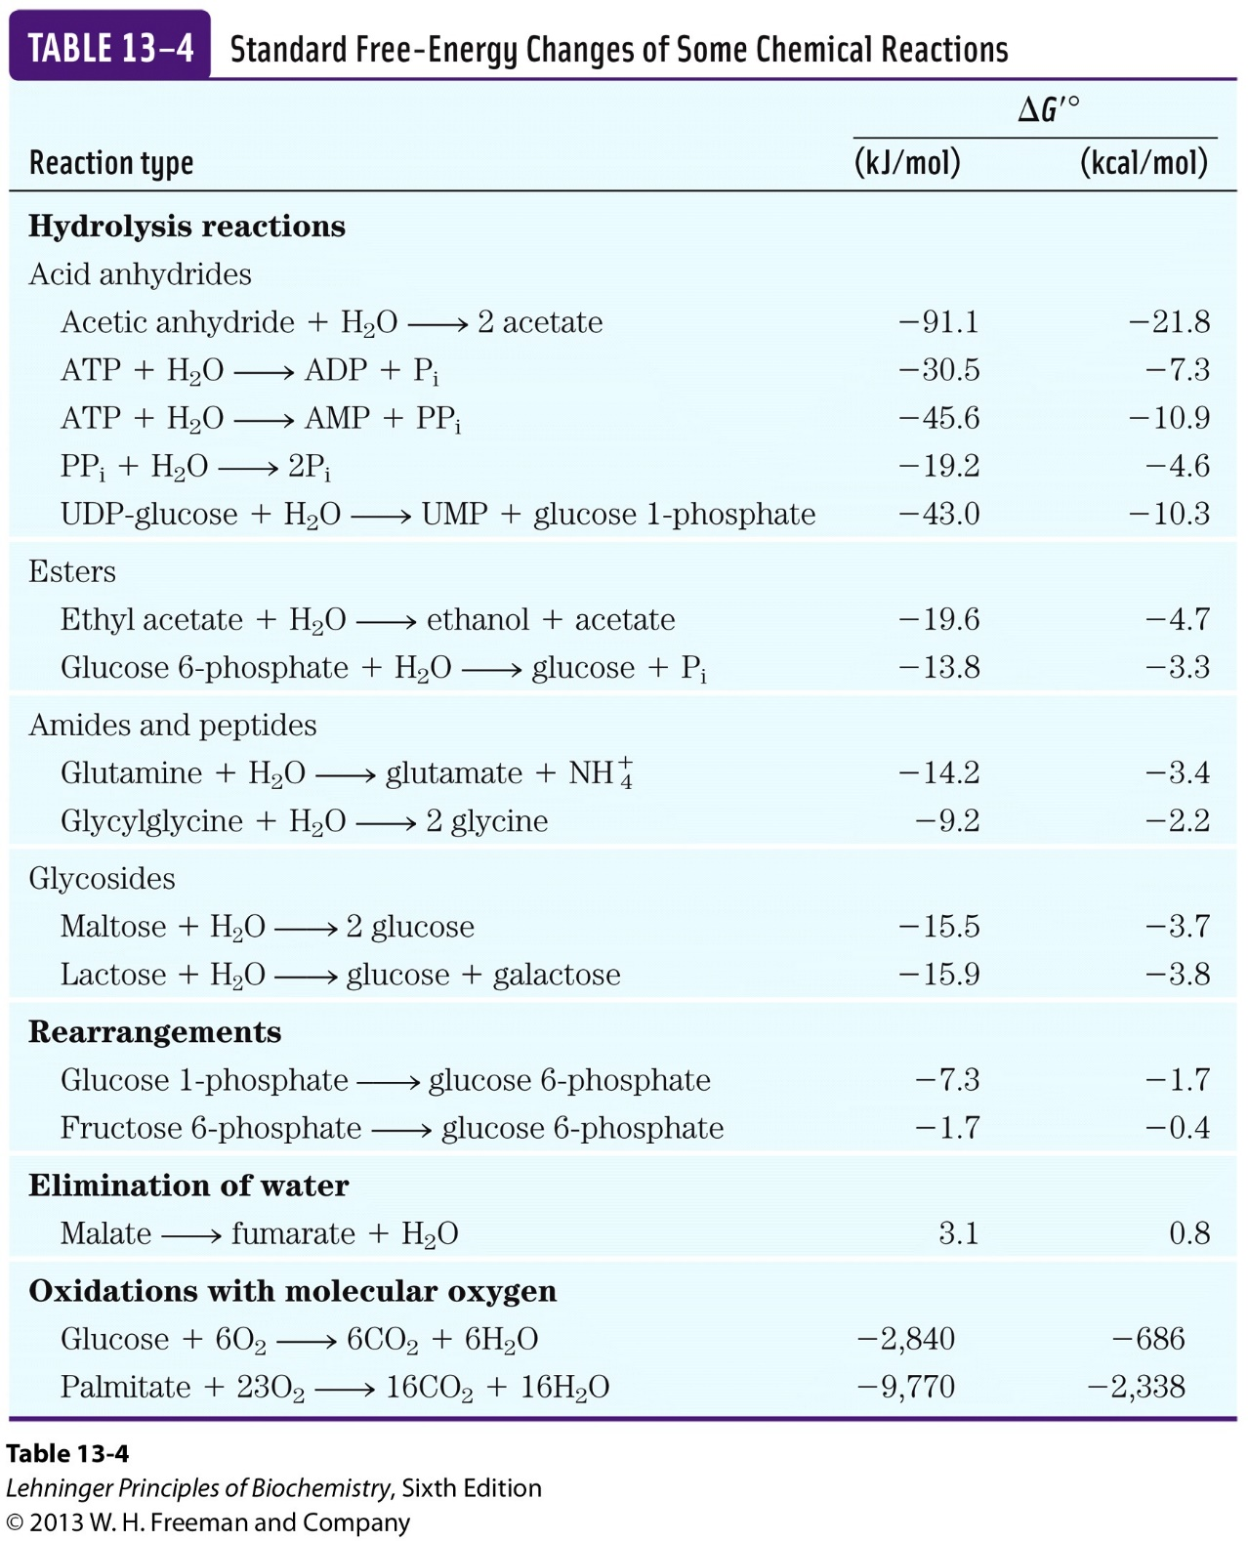

Slide 20
Most biochemical reactions fall into 5 general (not mutually exclusive) categories
1. Making or breaking C-C bonds.
2. Internal rearrangements (isomerization and elimination).
3. Free-radical reactions.
4. Group transfer.
5. Oxidation-reduction.

Slide 21
Reaction coupling in biochemistry
ΔG'ºs are additive

Slide 22
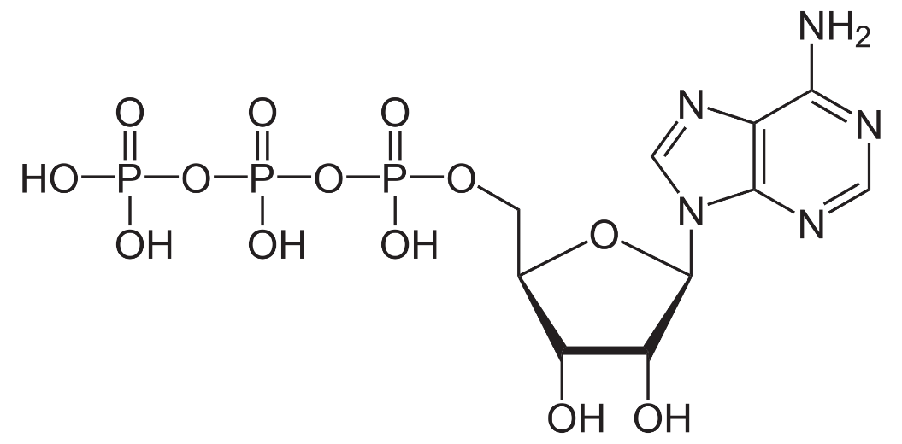
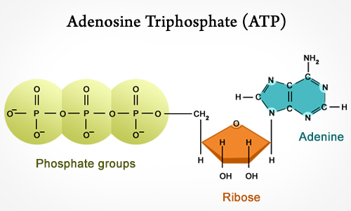
ATP, the universal currency of biological energy
This was first perceived by Fritz Lipmann and Herman Kalckar in 1941 when studying glycolysis.
Hydrolysis of the two phosphoanhydride (磷酸酐键) bonds in ATP generate more stable products releasing large amount of free energy (ΔG'º is -30.5 kJ/mol; ΔG_{p} in cells is -50 to -65 kJ/mol).

Slide 23
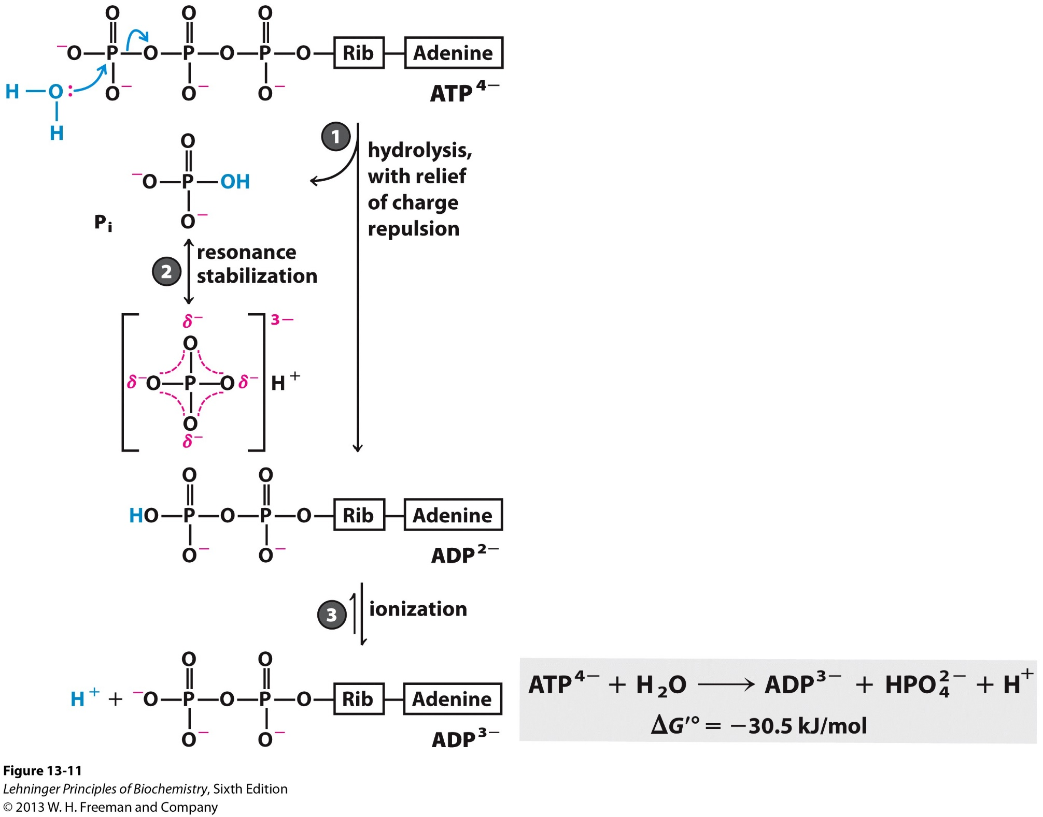
ATP hydrolysis is able to release a large amount of free-energy.
Four factors are important:
1. Relief of charge repulsion;
2. Resonance stabilization;
3. Ionization;
4. Stabilization due to hydration.
There is no such thing as
“high-energy phosphate bond”
as long used before.

Slide 24
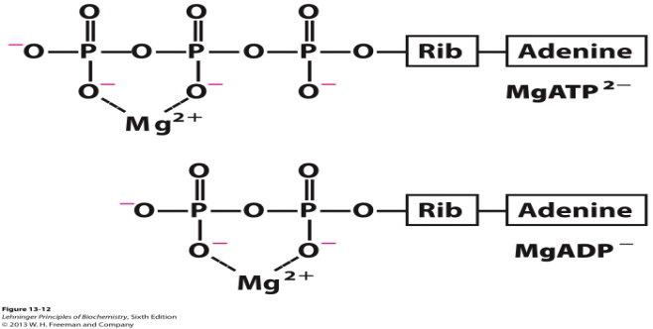
ATP, the universal currency of biological energy
The ATP molecule is kinetically stable at pH 7 and enzyme catalysis is needed for its hydrolysis.
ATP actually exists as a sum of various species in cells (e.g., ATP⁴⁻ and MgATP²⁻).
The human body on average contains only 250 grams of ATP but turns over its own body weight equivalent (~60,000 grams) in ATP each day!

Slide 25
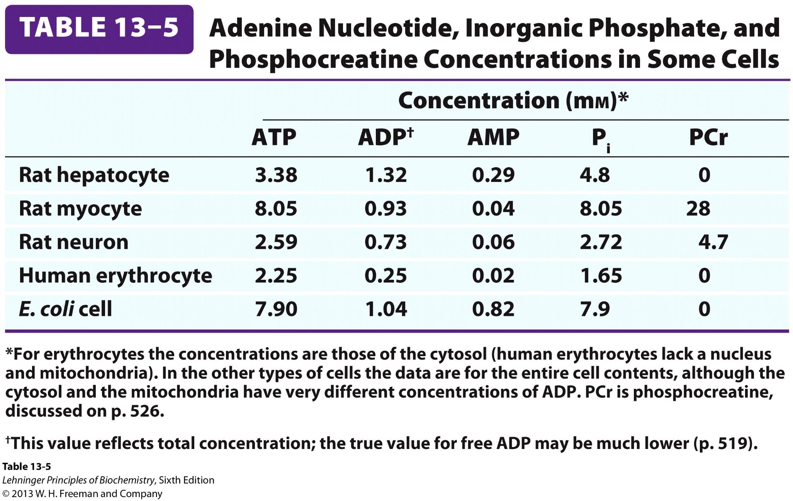

Slide 26
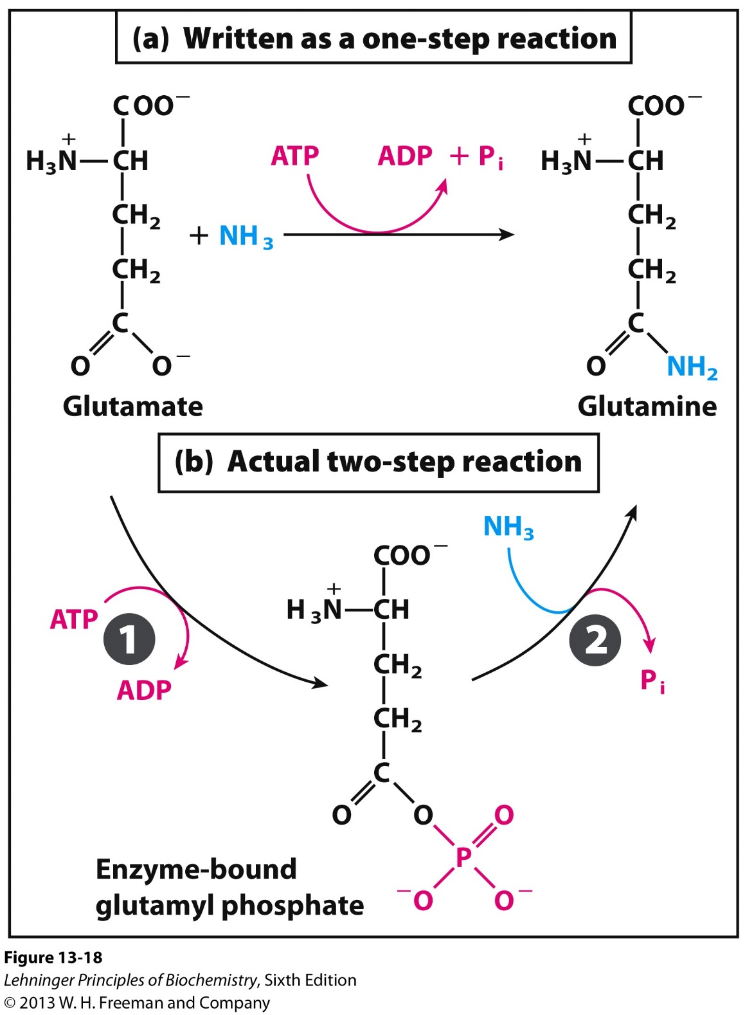
ATP provides energy usually through group
transferring, not simply hydrolysis, but the latter does occur in driving cyclic conformational changes of proteins to generate mechanical motion.

Slide 27
A comparison between the two modes of ATP action
ATP
ADP + Pi
E
E
ATPase
ATP
ADP
S
S
P
Kinase

Slide 28
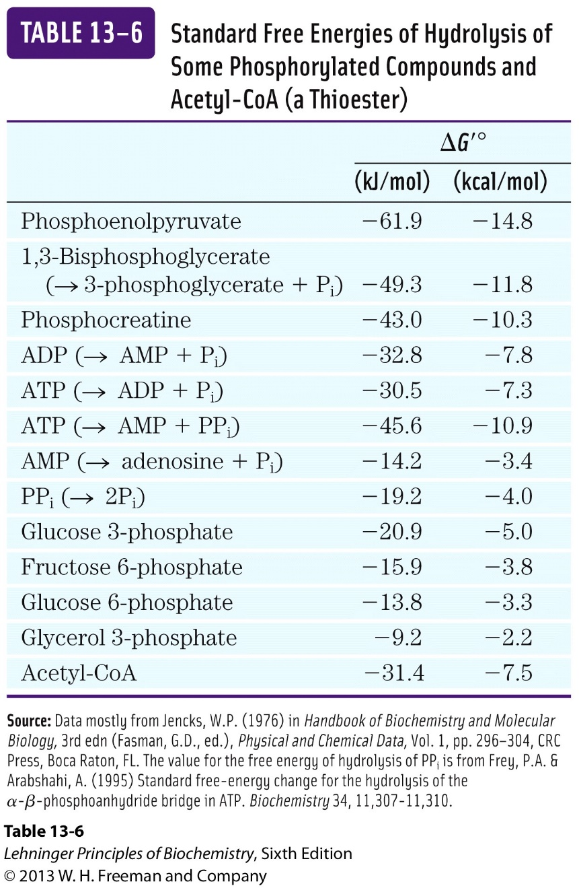
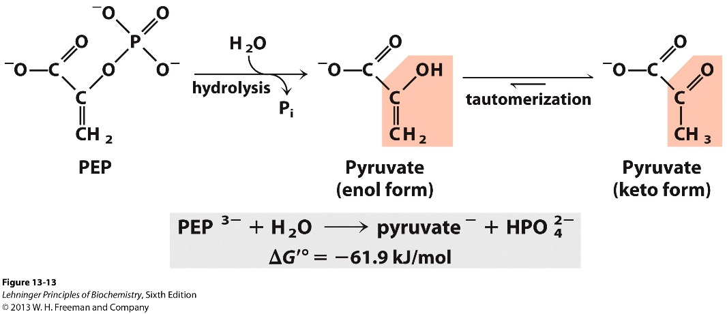
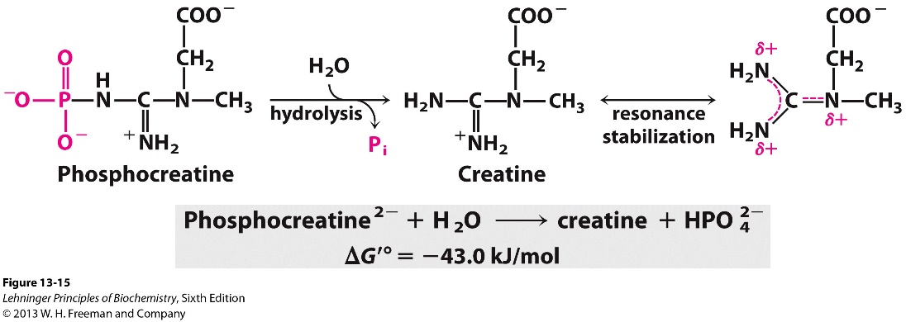
Other phosphorylated compounds as energy sources

Slide 29
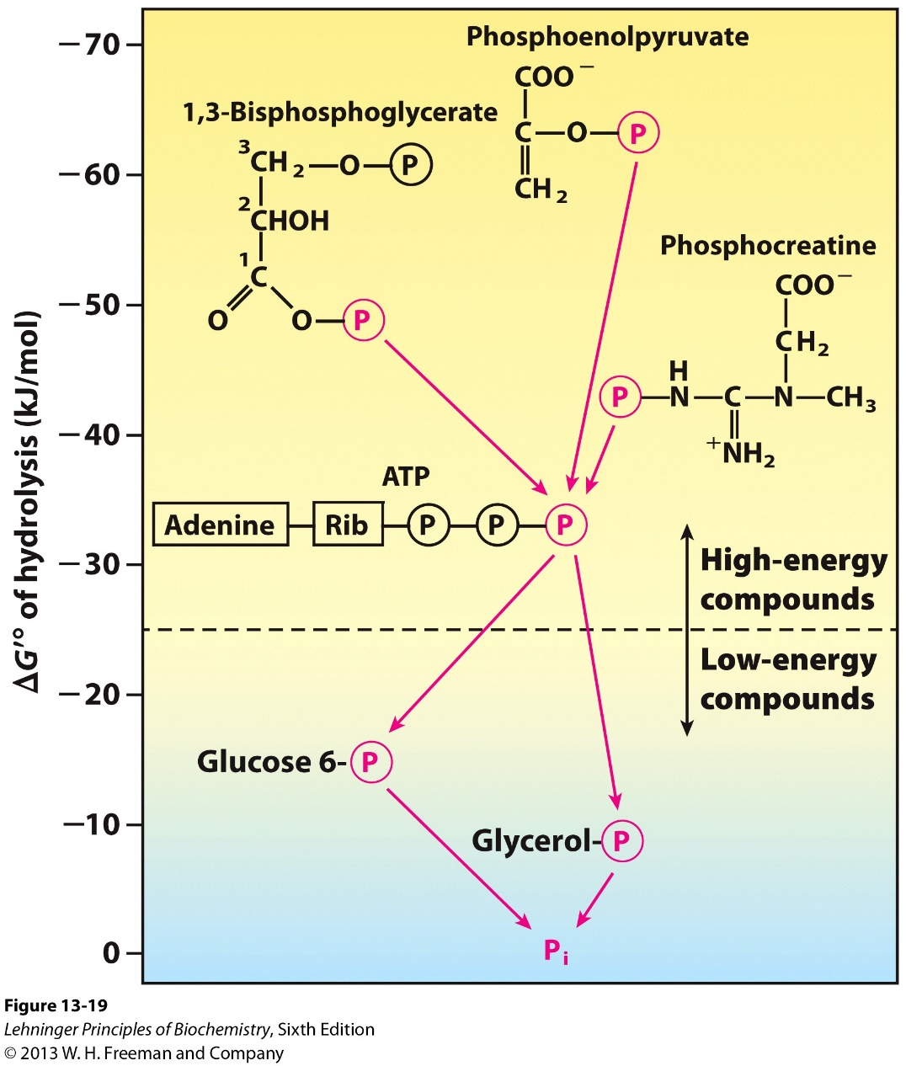
ATP has an intermediate phosphoryl group transfer potential, thus ADP can accept and ATP can donate phosphoryl groups (forming the ATP-ADP cycle and acting as an energy currency)

Slide 30
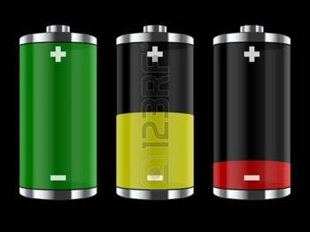

Slide 31
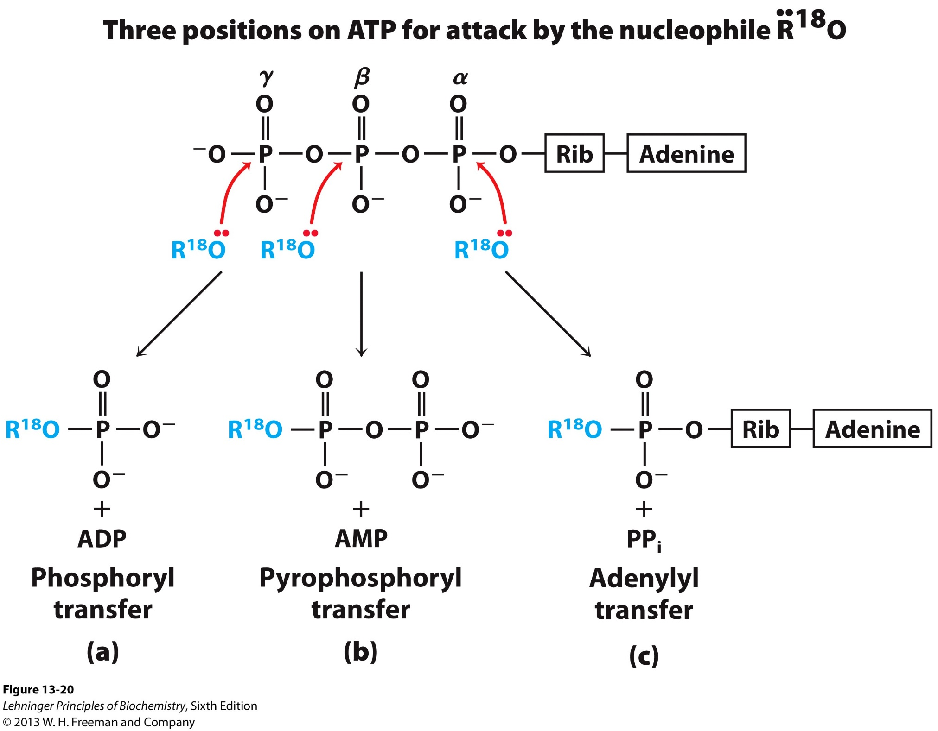

Slide 32
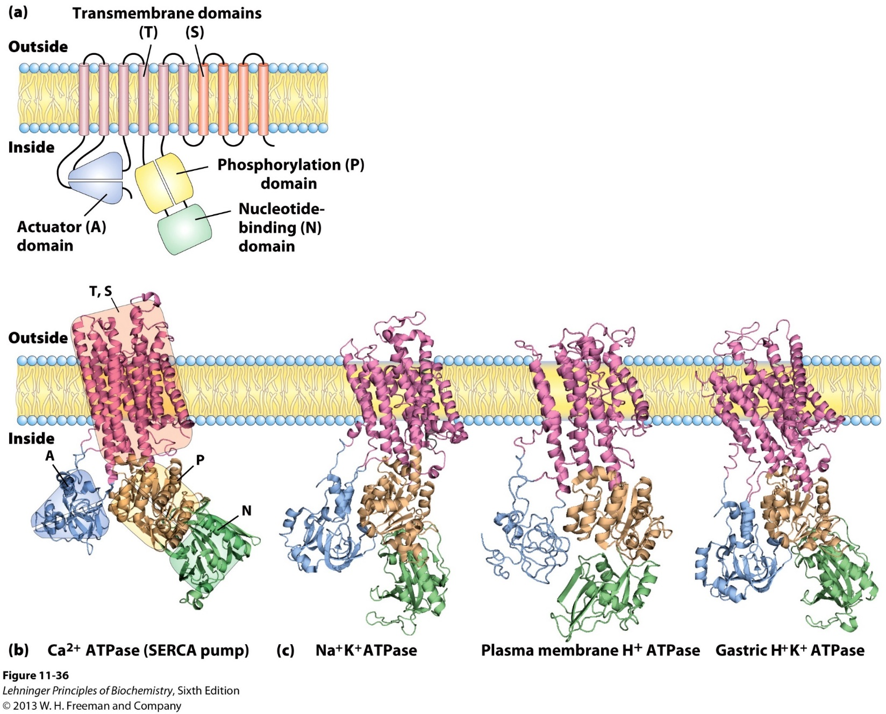
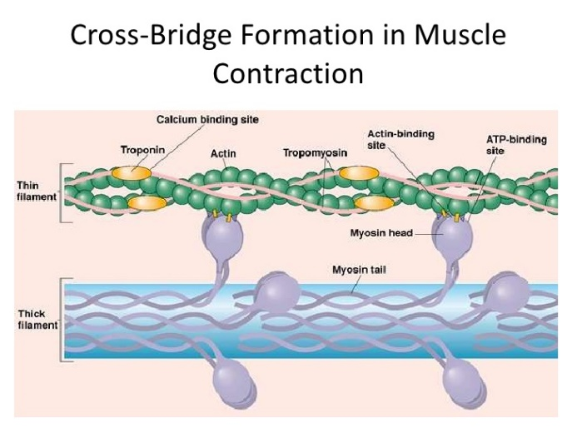
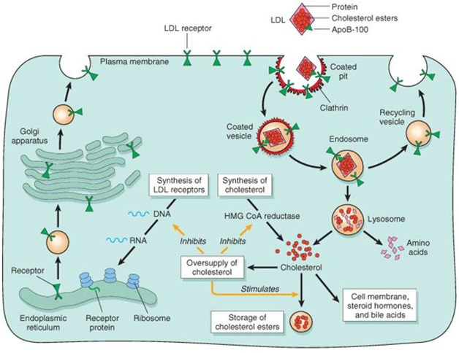
ATP (energy currency) driven cellular processes

Slide 33


Slide 34
Anabolism (reductive) and catabolism (oxidative)
Reductive
Forming more bands with H
Gaining electrons
Oxidative
Forming more bands with O₂
Losing electrons

Slide 35
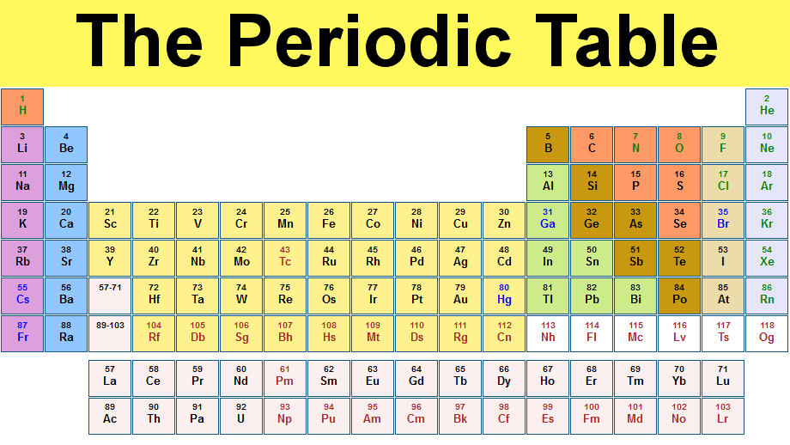

Slide 36
Different compounds are in different levels of oxidation, “own” different numbers of electrons
More electronegative atoms are considered to own the shared electrons.
Biological oxidations often involve dehydrogenation, and are catalyzed by many dehydrogenases.
Not all biological oxidation-reduction reactions involve carbon.
Electronegativity
H < C < S < N < O

Slide 37
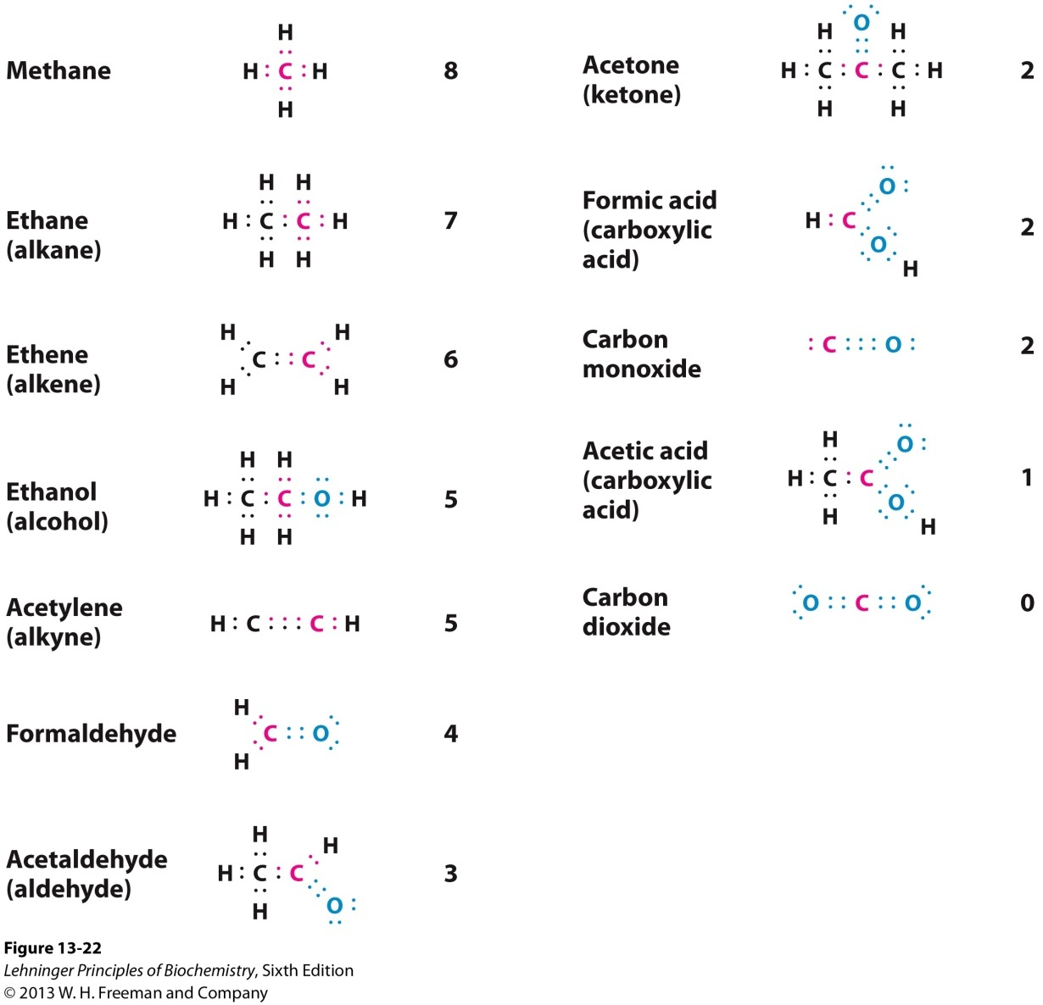
Different compounds are in different levels of oxidation, “own” different numbers of electrons
Electronegativity
H < C < S < N < O

Slide 38
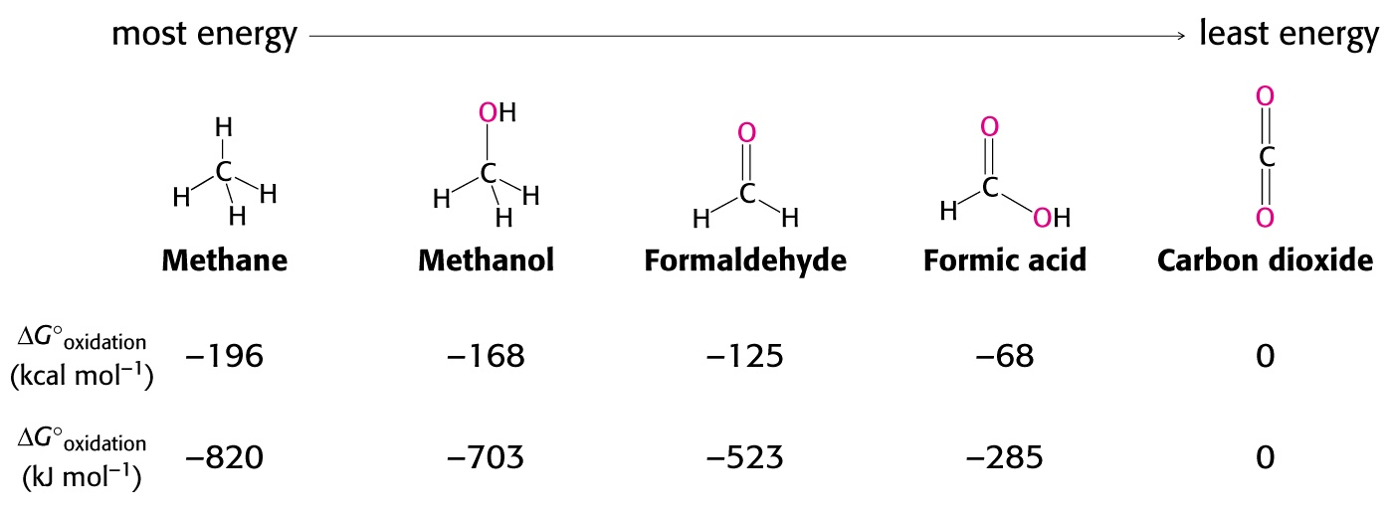
Functional groups in organic compounds present in one of four general oxidation states
Fully reduced
Fully oxidized
In aerobic organisms, the ultimate electron acceptor in the
oxidation of carbon is O₂, and the oxidation product is CO₂

Slide 39
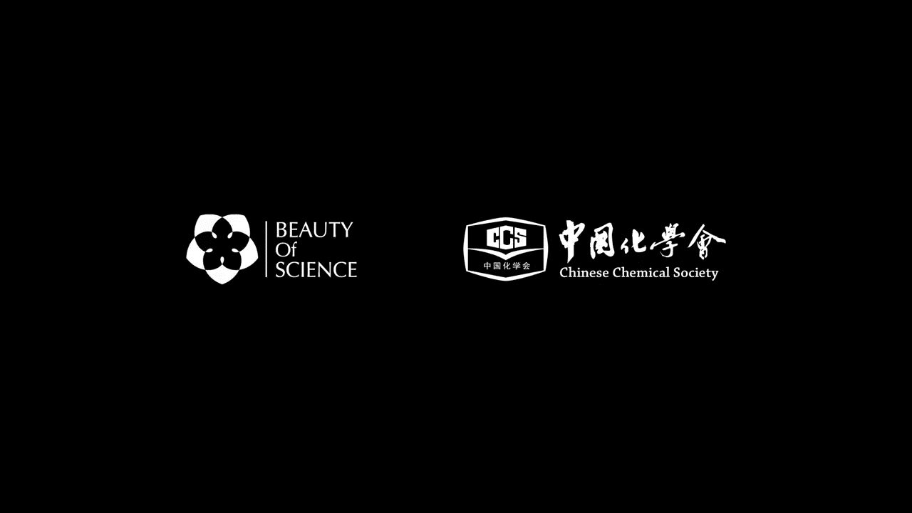

Slide 40
Oxidation-Reduction can be described as half reactions
Reducing agent/reductant: the one donating (giving up) electrons
Oxidizing agent/oxidant: the one accepting electons
Redox pair: when one agent is oxidized, something has to be reduced.

Slide 41
Free energy change in oxidation-reduction reactions can be calculated from the reduction potentials
Reduction potential E' (in volts) measures the tendency of a chemical species to acquire electrons (affinity for electrons).
The convention: more positive the potential, the greater the species' affinity for electrons (attracting electrons) and tendency to be reduced.

Slide 42
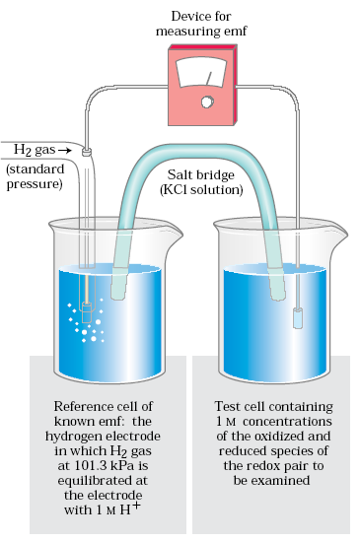
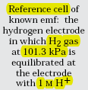
Standard reduction
potential (E'º) is measured by using the standard hydrogen electrode (SHE) as the reference.
positive E' º takes electrons from the reference cell
negative E' º donates electrons from the reference cell
H⁺ + e-，→1/2H₂
pH 0
Test cell
(pH 7)
E' º = 0.00 V

Slide 43
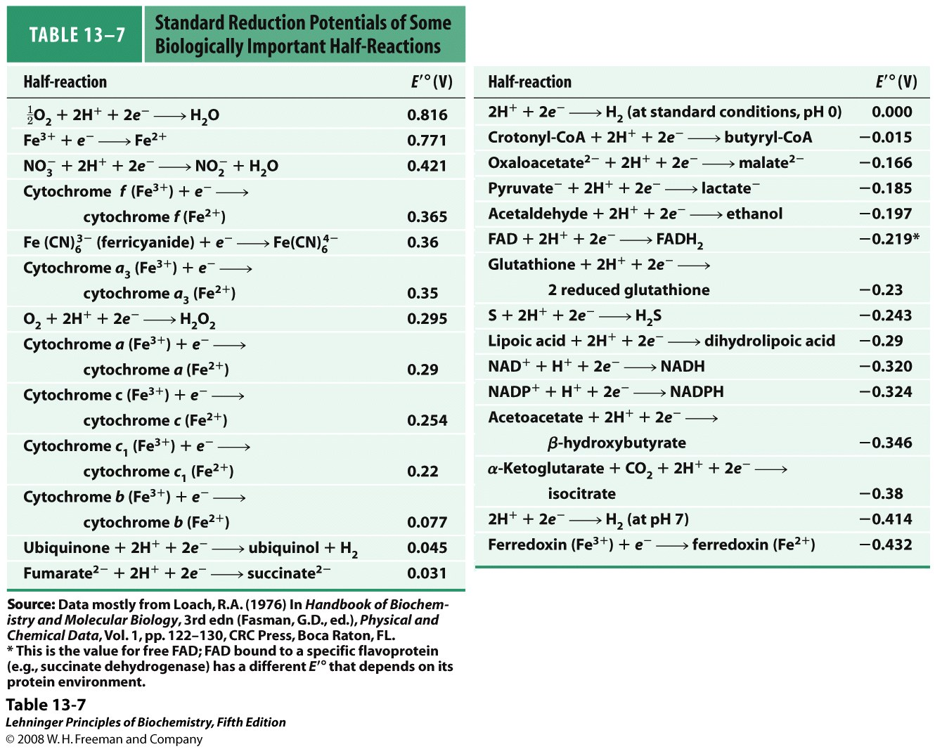
Standard reduction potentials of biologically important half-reactions have been systematically measured.
More positive, stronger capacity to take e⁻.

Slide 44
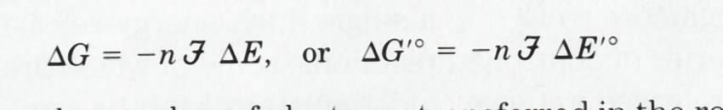
ΔG can be calculated from ΔE
ΔG of a redox reaction can be directly calculated from the value of ΔE (= E of the electron acceptor – E of the electron donor):
When ΔE is positive, ΔG is negative.

Slide 45
Standard reduction potentials of biologically important half-reactions have been systematically measured.
½ O₂ + H₂ H₂O
More positive, stronger capacity to take e⁻.

Slide 46
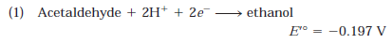
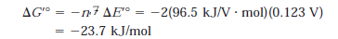
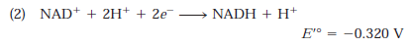
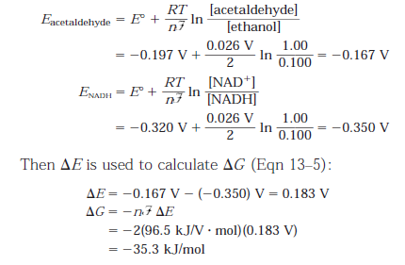
Actual free energy change can be calculated from reduction potential differences
If acetaldehyde and NADH were present at 1.00 M
but ethanol and NAD+ were present at 0.10 M
The actual free energy
change may also be
Calculated using the
following equation, as
done in the textbook

Slide 47
Anabolism (reductive) and catabolism (oxidative)
Reductive
Forming more bands with H
Gaining electrons
Storing energy
Oxidative
Forming more bands with O₂
Losing electrons
Releasing energy

Slide 49
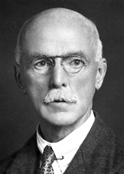
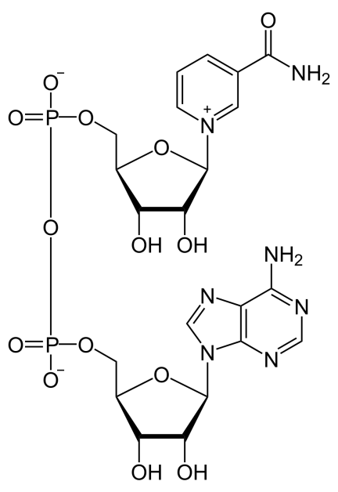
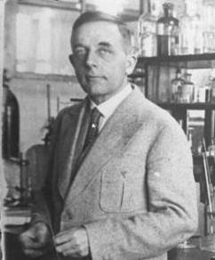
Nicotinamide adenine dinucleotide (NAD⁺) was found to be a common cofactor for hydrogen-transferring enzymes (1906)
Harden & Young (1906). "The Alcoholic Ferment of Yeast-Juice". Proc.Roy.Soc.78: 369–375.
Warburg & Christian (1936). "Pyridin, the hydrogen-transferring component of the fermentation enzymes (pyridine nucleotide)". Biochemische Zeitschrift 287: 291-328.
Harden
Being thermostable and filtratable;
Composed of adenine, nicotinamide,
pentose, and phosphate in the ratio
1:1:2:3.
The nicotinamide portion reversibly
carries hydrogen.
Warburg
A dinucleotide

Slide 50
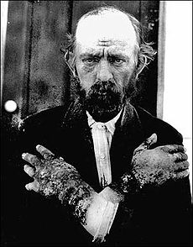
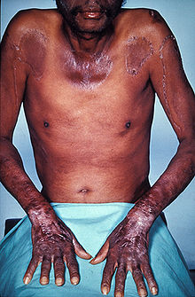
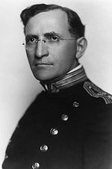
Pellagra (癞皮病), a type of Vitamin deficiency
3 “D”s:
Dermatitis
Diarrhea
Dementia (失忆)
In the early 1900s, pellagra reached epidemic proportions in the American South.
In 1915, Dr. Joseph Goldberger showed it was linked to diet. By modifying the diet Goldberger was able to show that pellagra could be prevented.

Slide 51
Pellagra (癞皮病), infection or diet?
Orphanage and hospital patients have higher incidents, but doctors or nurses don’t:
Diet as a possibility
Selected prisoners, provided restricted diets and induced Pellagra
Diet is linked to Pellagra, but specific ingredients were not identified
Didn’t have a chance to reverse diet-induced Pellagra (as the prisoners were soon released)
In 1938, other physicians showed that niacin is the active ingredients, which can reverse Pellagra.
From Wikipedia

Slide 52
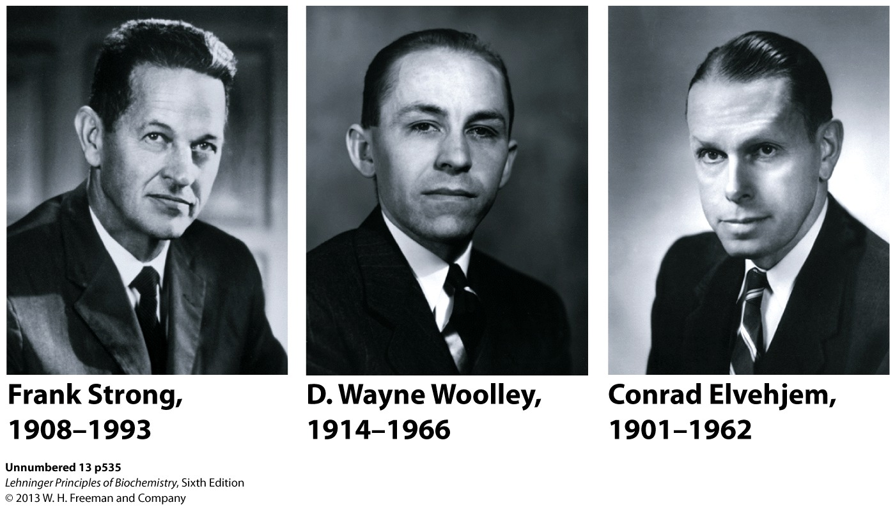


Niacin is the precursor to synthesize NAD/NADP

Slide 53

NAD/NADP found to be universal electron carriers of hydride ion (2 e⁻)
Benzenoid
form
quinonoid
form
NADP⁺: Nicotinamide adenine dinucleotide phosphate.
Being soluble coenzymes of dehydrogenases

Slide 54

NAD⁺ and NADH display different absorption
Absorbs light at 340 nm
upon reduction.

Slide 55

NAD⁺/NADH cycle (oscillation) imaged in cells
https://elifesciences.org/articles/27293/

Slide 56
NAD⁺/NADH cycle (oscillation) imaged in cells
https://elifesciences.org/articles/27293/

Slide 57
NAD⁺/NADH ratio: indicator of the redox state of cells
Total NAD⁺ and NADH: 10⁻⁵ M
NAD⁺ / NADH: ~700
Favoring electron acceptance by NAD⁺
NAD⁺ / NADH: function in oxidation, thus mostly in catabolism
Total NADP⁺ and NADPH: 10⁻⁶ M
NADP⁺ / NADPH: ~0.005
Favoring electron donation by NADPH
NADP⁺ / NADPH: function in reduction, thus mostly in
anabolism
Changes in NAD⁺ / NADH ratios (redox state) reflects metabolic activity and cell health

Slide 58

NAD and NADP bind at the highly conserved Rossman fold (β-α-β-α-β) structure in hundreds of dehydrogenases
A Rossman
fold

Slide 59

FMN/FAD was found as a common iron-free yellow pigment involved in respiration (1934)
Ellinger and Koschara (1934) The lyochromes: A new group of animal pigments. Nature 133:553-556.
Flavin
adenine
Dinucleotide
(FAD)
Flavin
mononucleotide
(FMN),

Slide 60

★ FAD & FMN are tightly bound (noncovalently or covalently) prosthetic groups in flavoproteins; ★ Being 1e⁻ or 2e⁻ carriers; ★ Their E'º varies in different enzymes; ★ They are light-absorbing in cryptochromes (for mammalian circadian rhythms) and photolyases (for DNA repair).
FAD (FMN)
(Oxidized)
450 nm
360 nm
370 and 440 nm

Slide 61



Riboflavin (vitamin B₂) provides precursors for making FAD/FMN
Niacin
a vitamin
For curing Pellagra
Riboflavin
(vitamin B2)
NAD⁺
FAD

Slide 62
Summary
Bioenergy is chemical energy, studied in terms of free energy and free energy change (ΔG ).
ATP acts as the free energy carrier (currency) in cells.
Bioenergy is mainly produced via stepwise electron flow (redox reactions) through a series of electron carriers having increasing levels of reduction potential (E).
Electrons released from the oxidation of nutrient fuels are initially channeled to a few universal electron carriers (mainly NADH and FADH₂).

